Slide 1
Physical Activity Programs for Individuals with Fontan Circulation
FON Case Review Conference
July 18th, 2023

Slide 2
Outline
Children’s Wisconsin Experience:
Case Presentation
Clinic/Home-based Physical Activity Program
Children’s Hospital Colorado Experience:
Case Presentation
Virtual/Home-based Physical Activity Program

Slide 3
Physical Activity Programs for Individuals with Fontan Circulation
Children’s Wisconsin Experience

Slide 4
CW Case Presentation
9 y/o F with Hypoplastic left heart syndrome
  Norwood operation w/ mBT shunt (5 days/old)
  Bidirectional Glenn and TV repair (2.5 mo/old)
  Extracardiac fenestrated Fontan (2 years/old)
Presents for routine cardiology visit
  c/o SOB with activity
  feeling that she “can’t breathe in air fast enough” when active
Courtesy of Eliot May PA-C

Slide 5
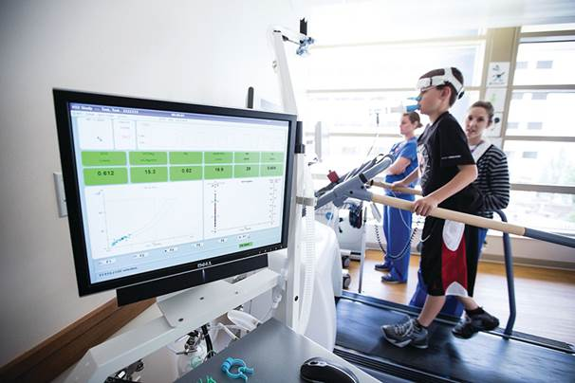
CW Case Presentation cont.
Cardiopulmonary Exercise Testing:
Treadmill with Bruce protocol
Exercise time = 10:27
Peak HR = 181 (86% pred)
O2 sat = 93% → 88%
Peak VO2 = 28.3 mL/kg/min (64% pred)

Slide 6
Reduced Exercise Capacity after Fontan
Data will be presented at the World Congress of Pediatric Cardiology and Cardiac Surgery;
Washington DC; August 2023

Slide 7
School’s, teacher’s, coach’s concerns
FACTORS THAT CONTRIBUTE TO EXERICSE LIMITATIONS IN FONTAN CIRCULATION
Musculo-Skeletal Deficits
Parental Barriers
Complex, Multifactorial, Multi-system, Physical Deconditioning
Patient’s Fears and/or symptoms
Failure to understand importance of activity
Mixed messages from care team
Cardio pulmonary Limitations
Neurologic Deficits
Figure courtesy of Michael Danduran Children’s Wisconsin
Notes:
The CDC reports 86% of schools regularly exempt students with long-term health conditions from physical education.

Slide 9

HHI “Steppin’ It Up” Physical Activity Program
Developed in 2017 following success of the pilot study
Goal: Increase physical activity in children with CHD
Multidisciplinary partnerships
  Psychology
  PT/OT
  Nutrition
  Marquette University
Activity Trackers
  Garmin
Exercise Protocols

Slide 10
“Steppin’ It Up” Program Structure
4 In-person Clinic visit over 12 months
Baseline
3 Months
6 Months
12 Months
MD
Exercise Physiologist
Psychology
Pacer Test
PT/OT
MD
Exercise Physiologist
Psychology
Pacer Test
Nutrition
MD
Exercise Physiologist
Psychology
Pacer Test
PT/OT
MD
Exercise Physiologist
Psychology
Pacer Test
TIER 1:
Developing the Habit
0-3 months
TIER 2:
Encouraging Choices
3-6 months
TIER 3:
Resources within the community
6-12 months

Slide 11
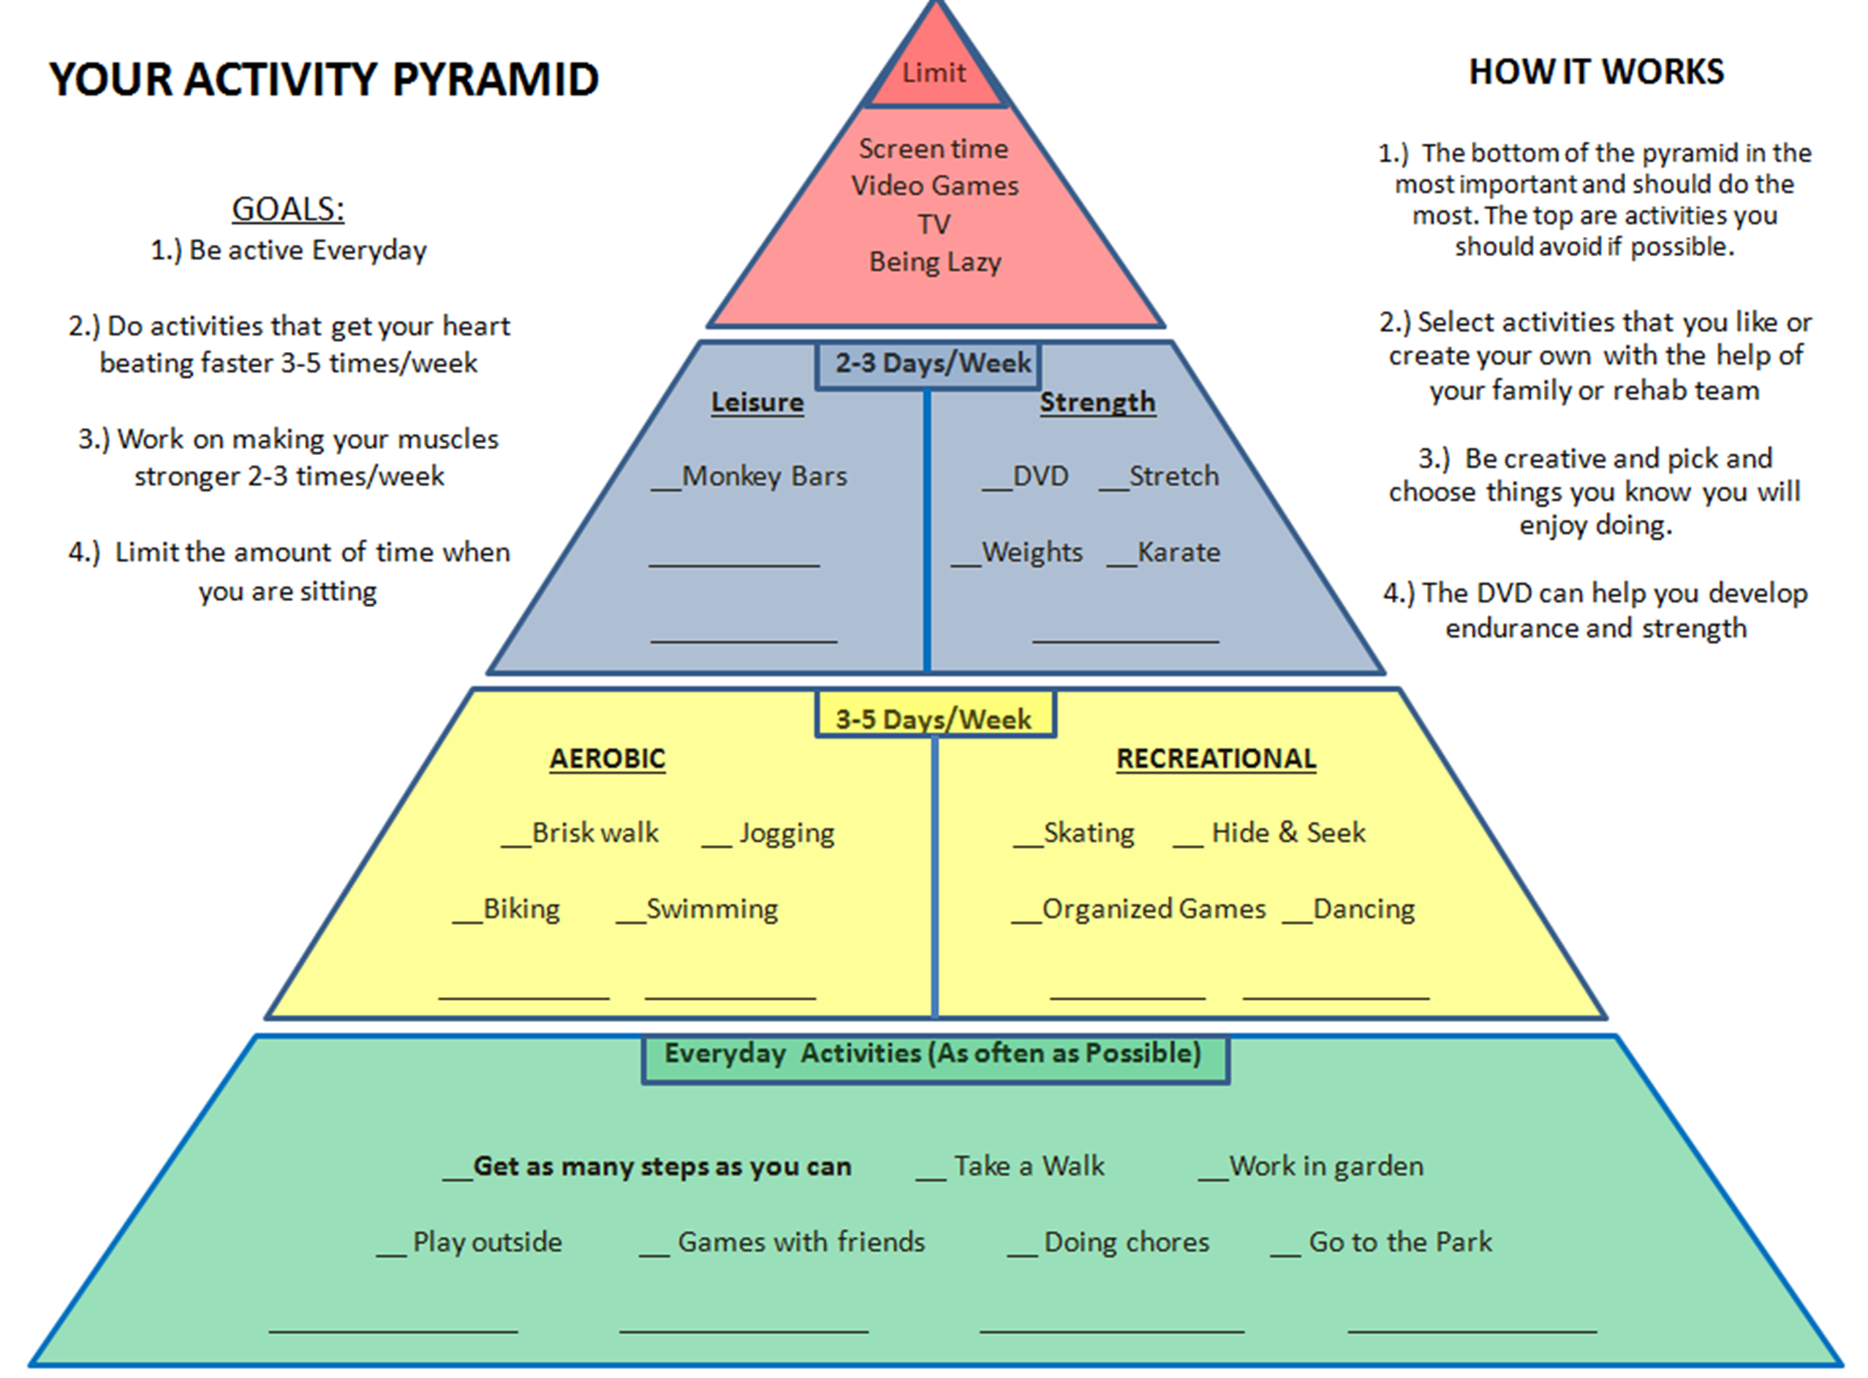
Exercise Prescription

Slide 12
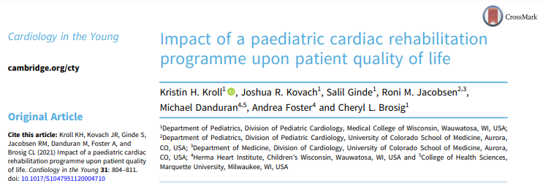

Slide 13
CW Case Presentation cont.
9 y/o HLHS s/p Fontan presented w/ exercise intolerance
Completed Pilot Physical Activity Program
12-13 y/o Completed “Steppin’ It Up” Program
14-18 y/o
  Participated as competitive diver and rock climber for school teams
  Serial CPET demonstrated stable peak VO2 ≈ 65% predicted (No Decline)
  Graduated High School 6/2023, and heading to college this fall on nursing track!

Slide 14
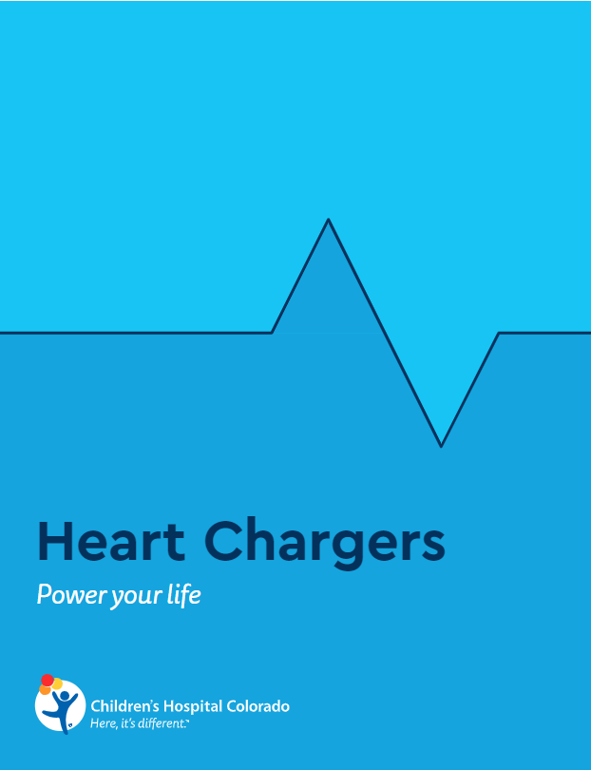
Heart Chargers
Children’s Hospital Colorado Experience
July 18, 2023
Roni Jacobsen, MD, FACC
Julie Fernie, MS ACSM-CEP

Slide 15
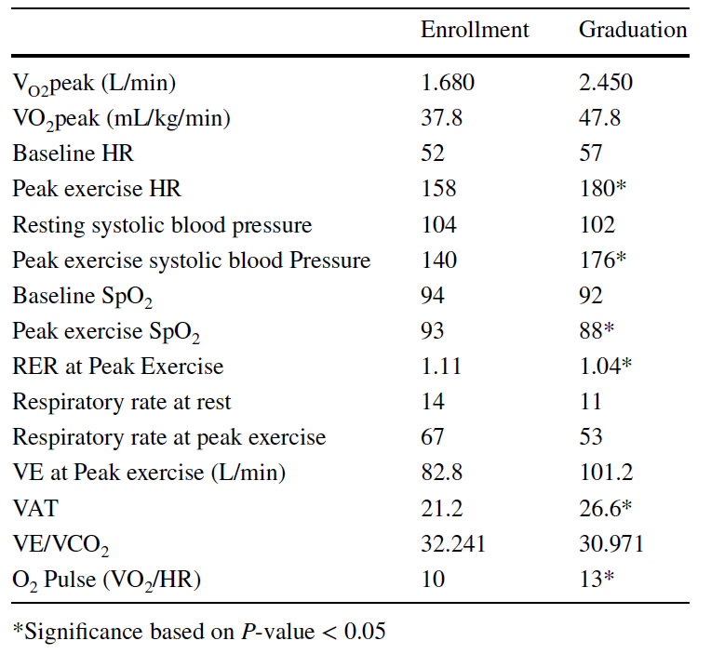
Case Presentation
14 y/o male with pulmonary atresia with intact septum
Modified BT shunt (infancy)
Bidirectional Glenn (~ 3 months old)
Fenestrated Fontan (~ 3.5 years old)
Referred to Heart Chargers Program
Overall felt to be doing ok
Goal: Get faster and stronger
Graduation: Participating in Cross Country
Able to complete 2 miles in 14 minutes
Ran 8 miles prior to CPET

Slide 16
Heart Chargers​
Quality improvement project started in 11/2018 for Fontan patients​
​
Consent & assent obtained​ at enrollment
​
Reimbursable, 12-month, home-based, personalized exercise program utilizing a Garmin© activity monitor & telemedicine​
​
30-45 minutes of aerobic activities, with recommended goal heart rate & rate of perceived exertion (RPE) based on CPET​
Strength-training activities​
Respiratory strengthening activities​
Option to meet with nutritionist​
​CPET at enrollment & graduation, with 6-minute walk at home to monitor exercise tolerance​
​

Slide 17
Periodic Exercise Prescription Updates
Individualized updates range from monthly to every 3 months, per participant request​, including discussion at each telemedicine visit
Progress from simpler to more complex strength movements​
Increase intensity as tolerated​
Interests change as kids gain confidence in exploring new activities​
Seasonal changes in interests​
Update to avoid burnout

Slide 18
Heart Chargers: Global Findings
No adverse events​
Exercise outcomes variable
  5 mL/kg/min decrease to 10 mL/kg/min increase in VO2peak​
  Without intervention, anticipate 2-3% decrease in exercise capacity year-over-year​
Participant/family engagement associated with improved exercise outcomes​
Increase in peak exercise ventilation​
Strong subjective reports of improved confidence, feeling stronger, & joining sports teams/clubs​
Cardiopulmonary exercise tests and physician visits reimbursable by insurance

Slide 19
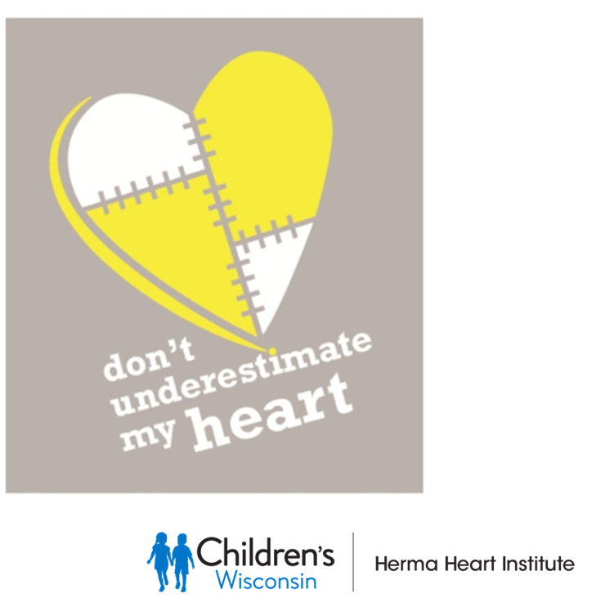
Program Challenges
Colorado
Scheduling constraints with single cardiologist
High drop-out rate prior to adopting consent and assent
Insurance, acceptable billing codes
Catchment area
Wisconsin
Motivation
Lost/absent activity trackers
Staffing/expansion
Cost
Referral bias

