Slide 1
Creation of Azygous Fontan Connection to treat pulmonary AVMs in Fontan
Howaida el-said, John Moore & Kanishka ratnayaka
Rady Children’s Hospital/ucsd

Slide 2
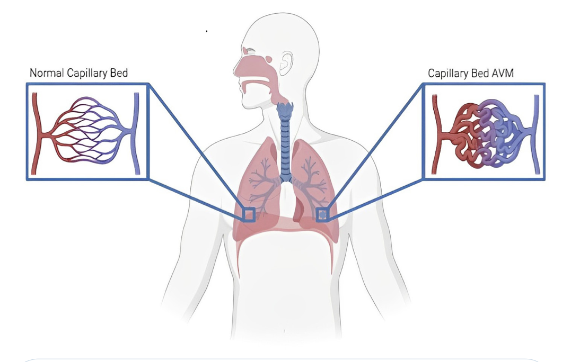

Slide 3
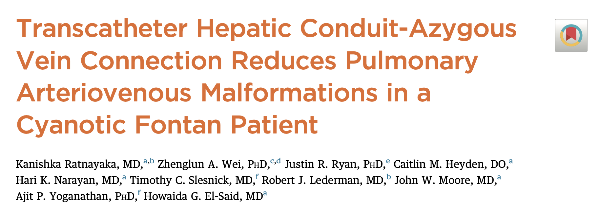

Slide 4
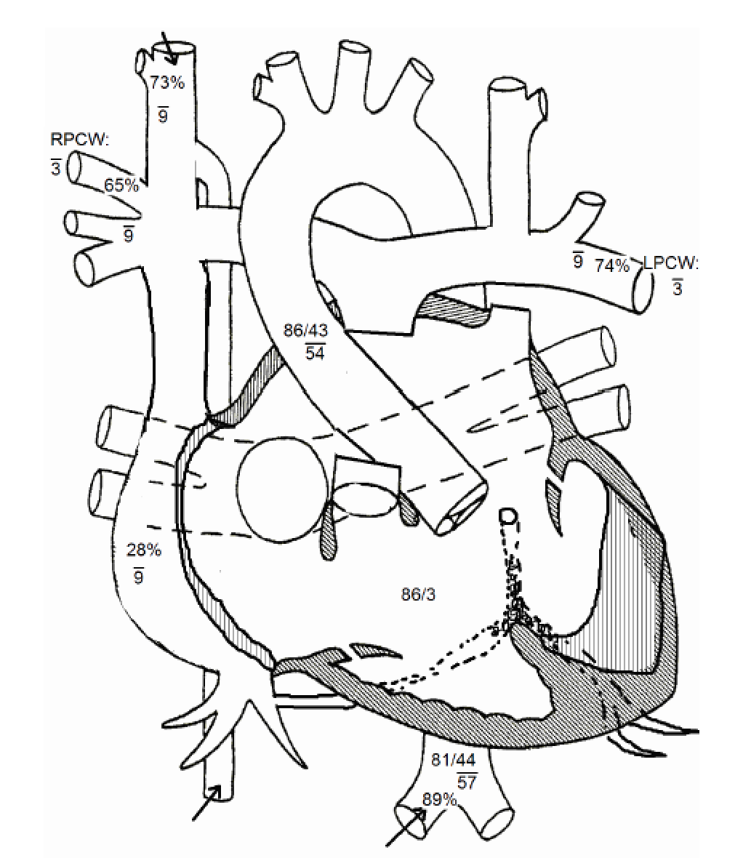
Patient Information
11 year old, Male, 24 kg
Single Ventricle Heterotaxy
Easy Fatigue with exertion
Significant AVMs in the left lung
Resting sats 89% decrease to 75% with exertion
Good Biventricular function

Slide 6
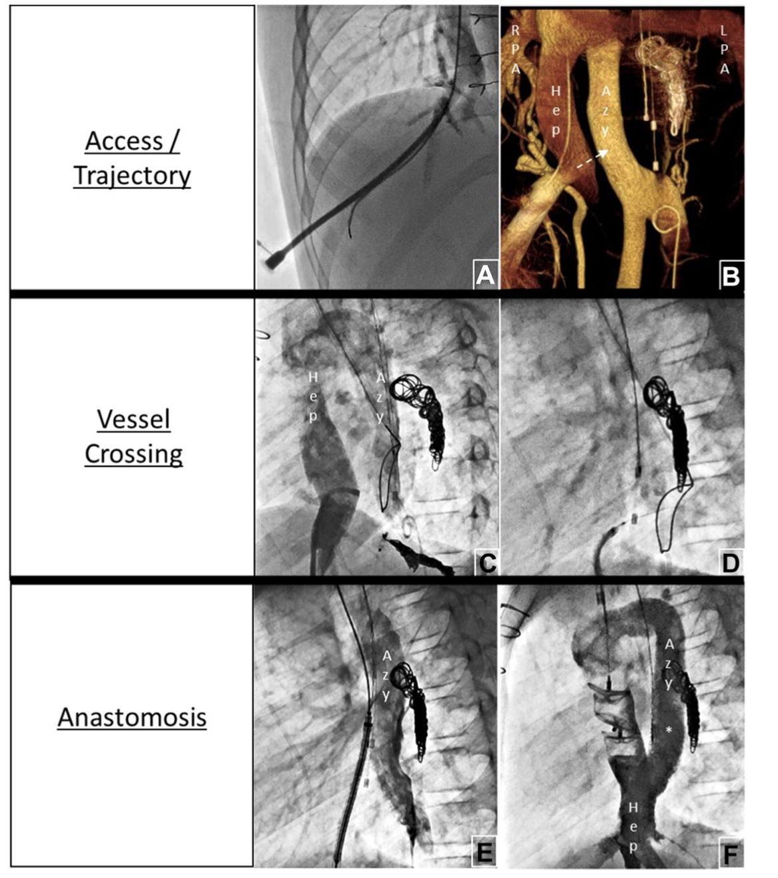

Slide 7
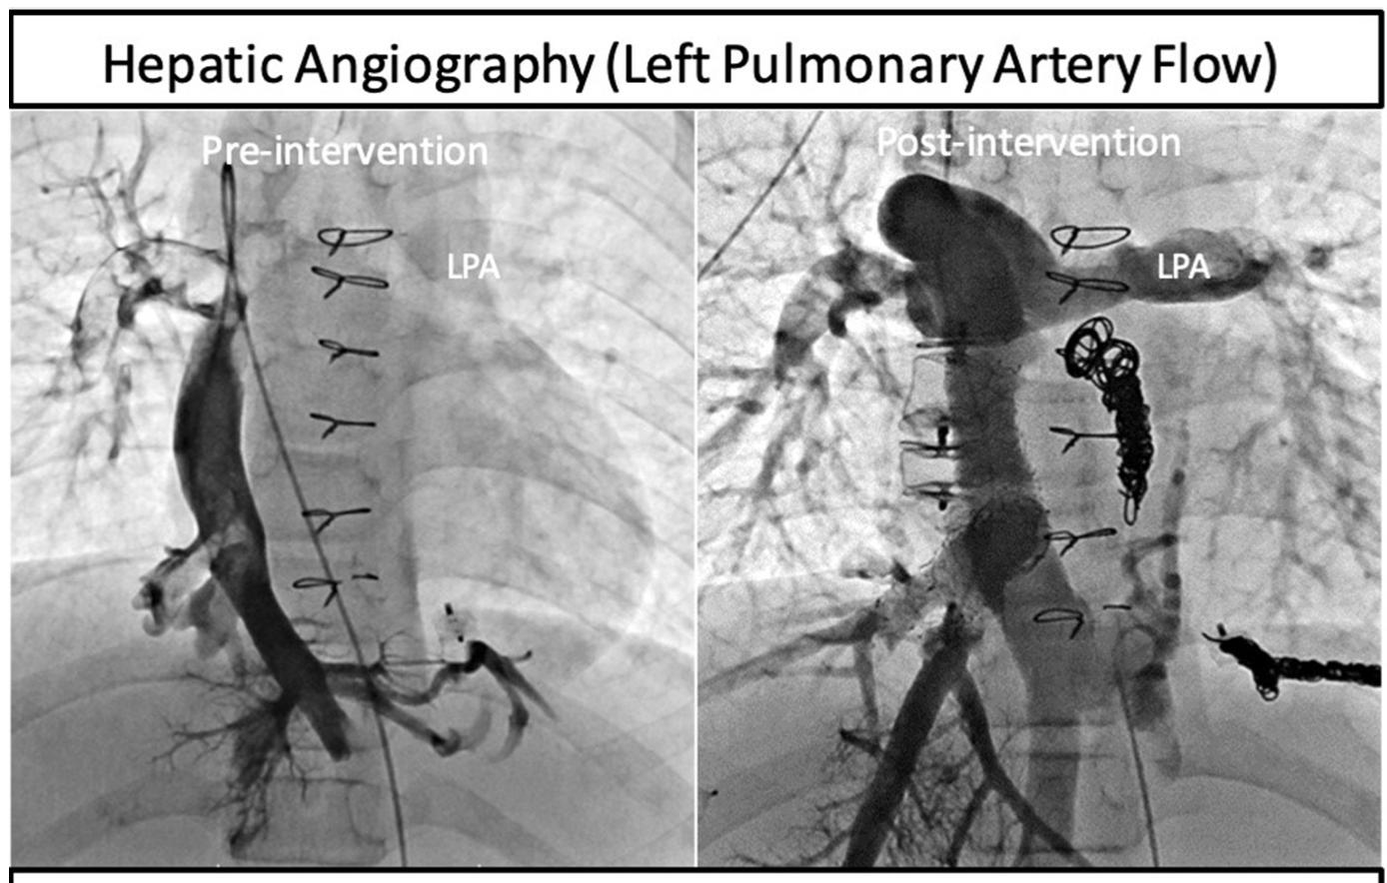

Slide 8
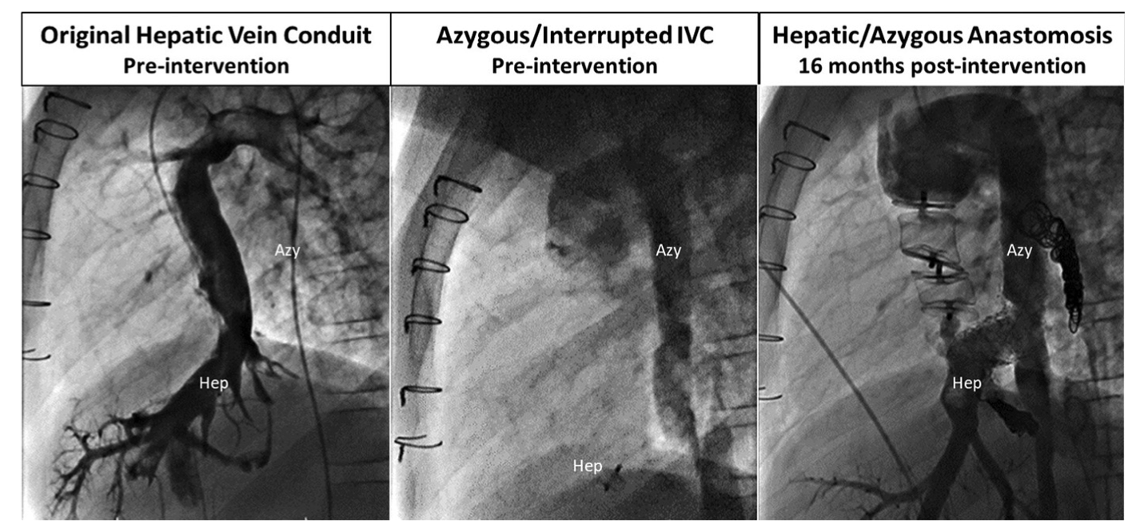

Slide 9
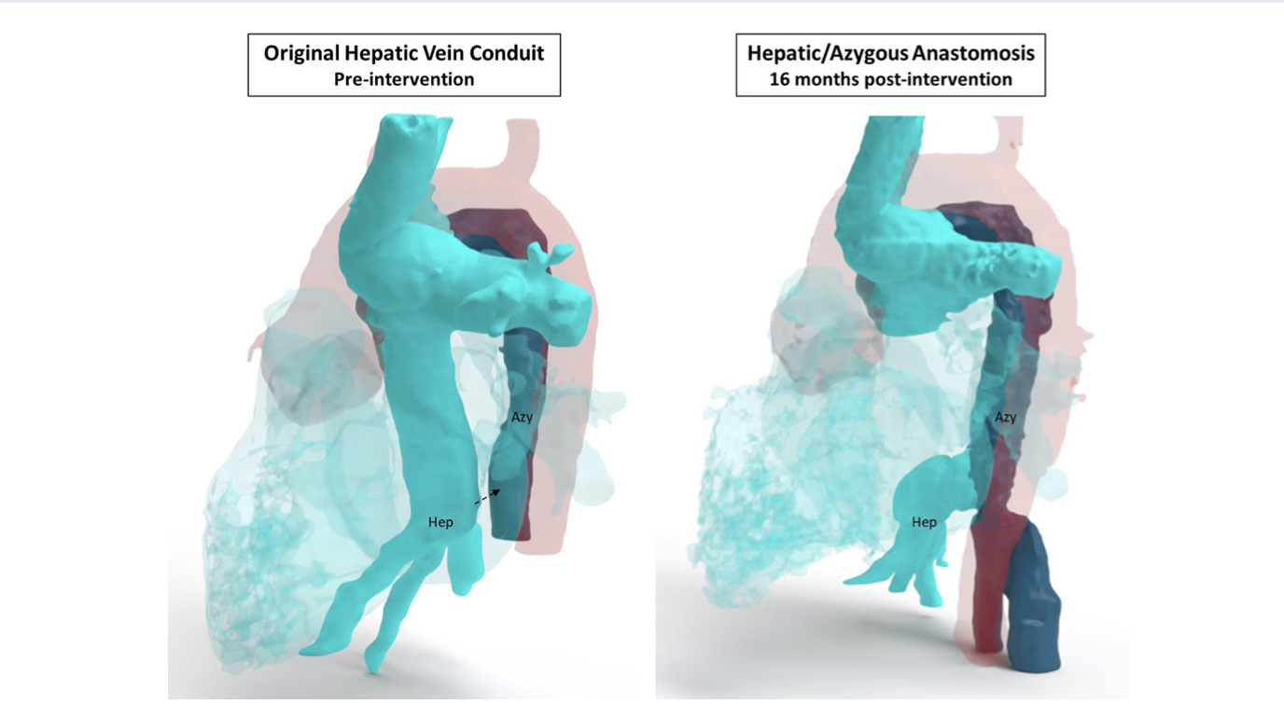

Slide 10
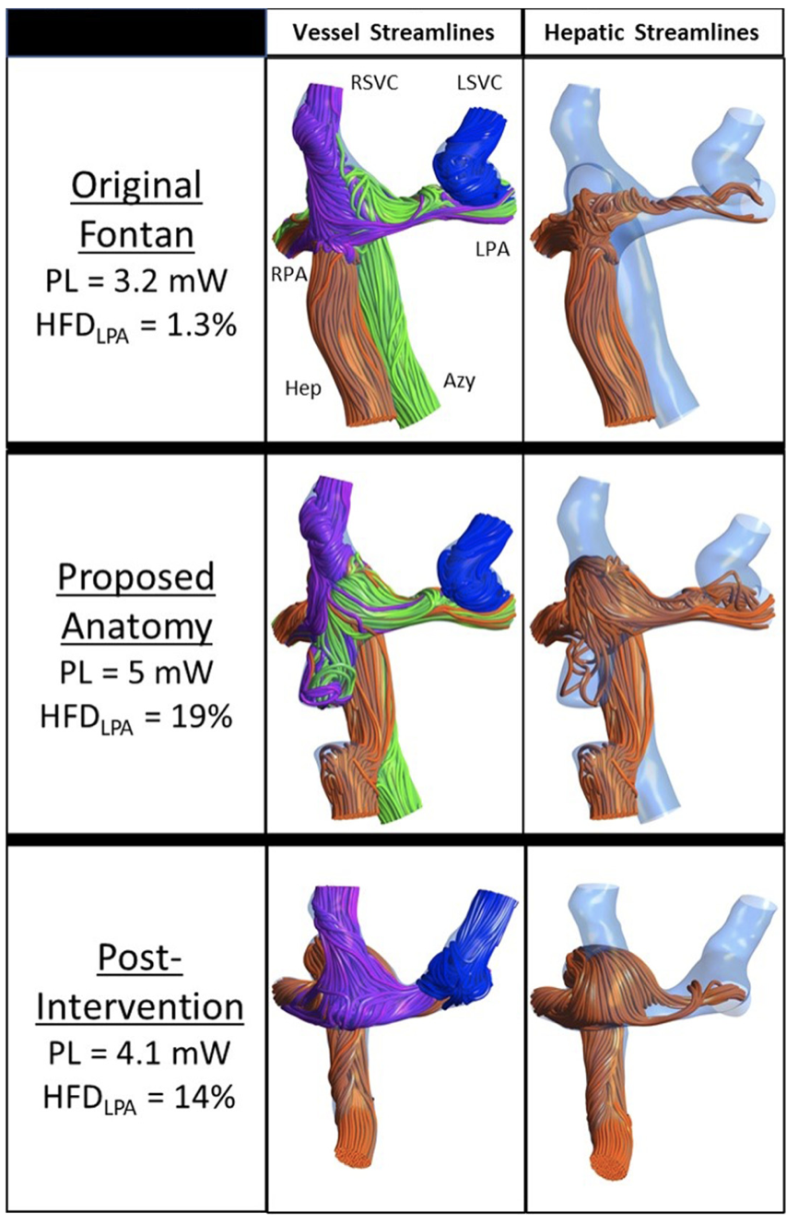

Slide 11
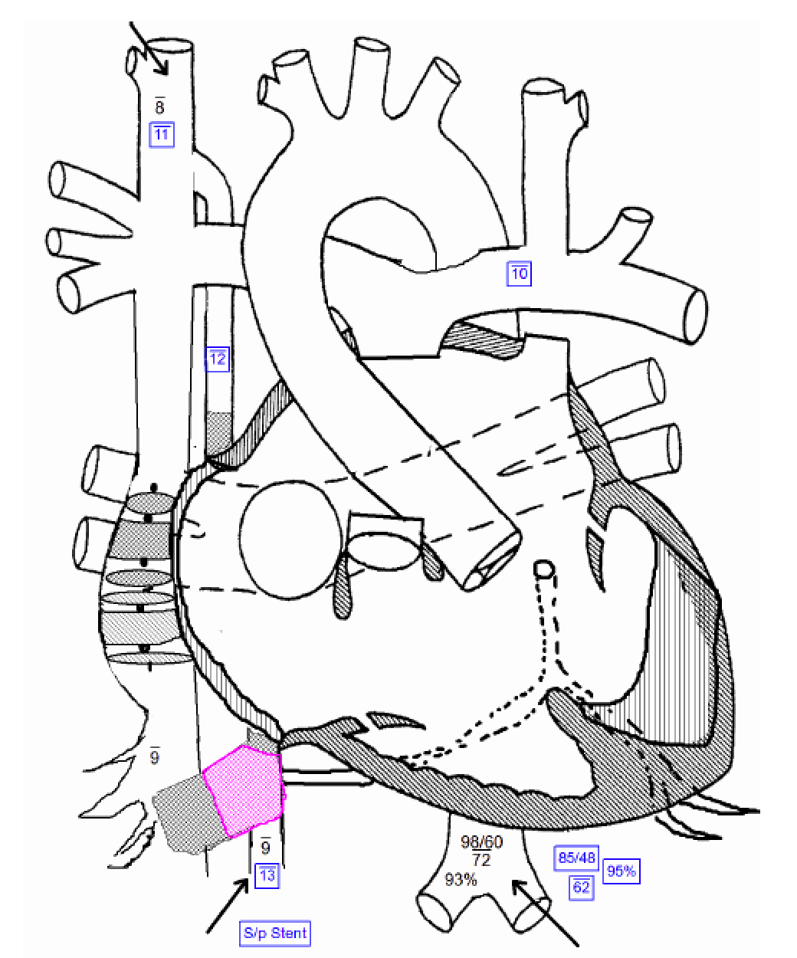
Follow up
Over 6 months
Easy Fatigue resolved
Resting sats 95% decrease to 85% with exertion
(compared to Resting sats 89% decrease to 75% with exertion)

Slide 12
Thank you

