Slide 1
The “Growing” Problem of Aortopathy in the post-Norwood Aorta
Host/Moderator | Jack Rychik, MD
Introduction to the Fontan Outcomes Network CRC | Jack Rychik, MD
Case #1 Presentation | Kathryn Dodds, MSN
Case #2 Presentation | Jack Rychik, MD
Imaging for cases 1 and 2 | Mark Fogel, MD
Unusual flow mechanics: a set up? | Mark Fogel, MD
Surgical approaches | Stephanie Fuller, MD
Panel Discussion with Audience Participation | Joseph Casey, Kathryn Dodds, MSN, Mark Fogel, MD, Stephanie Fuller, MD, David Goldberg, MD, Yuli Kim, MD
ADJOURN

Slide 2
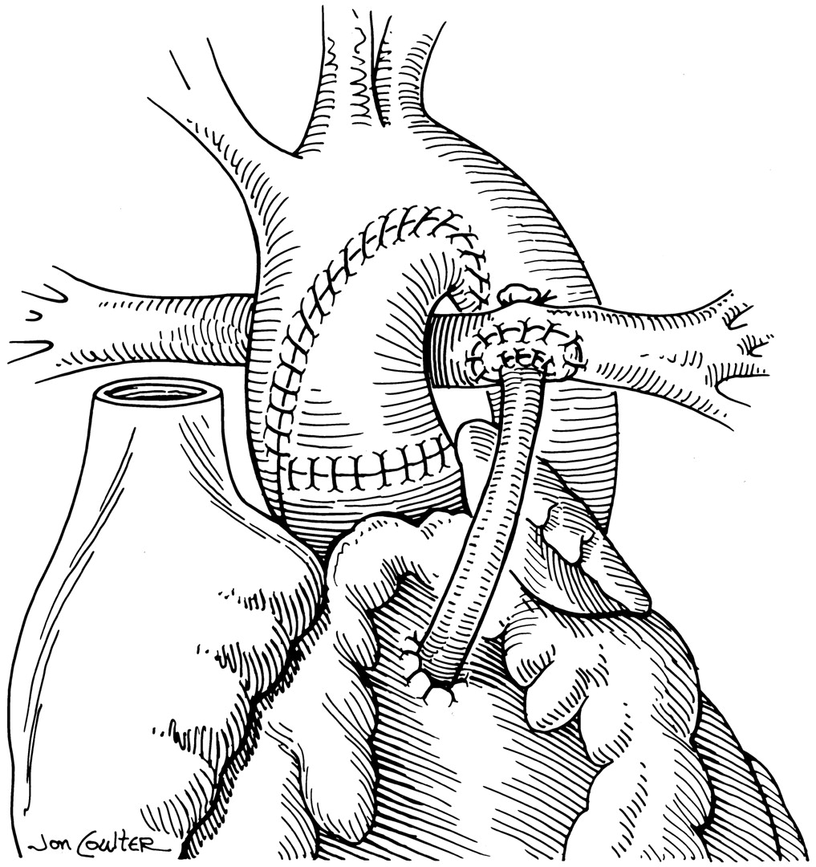
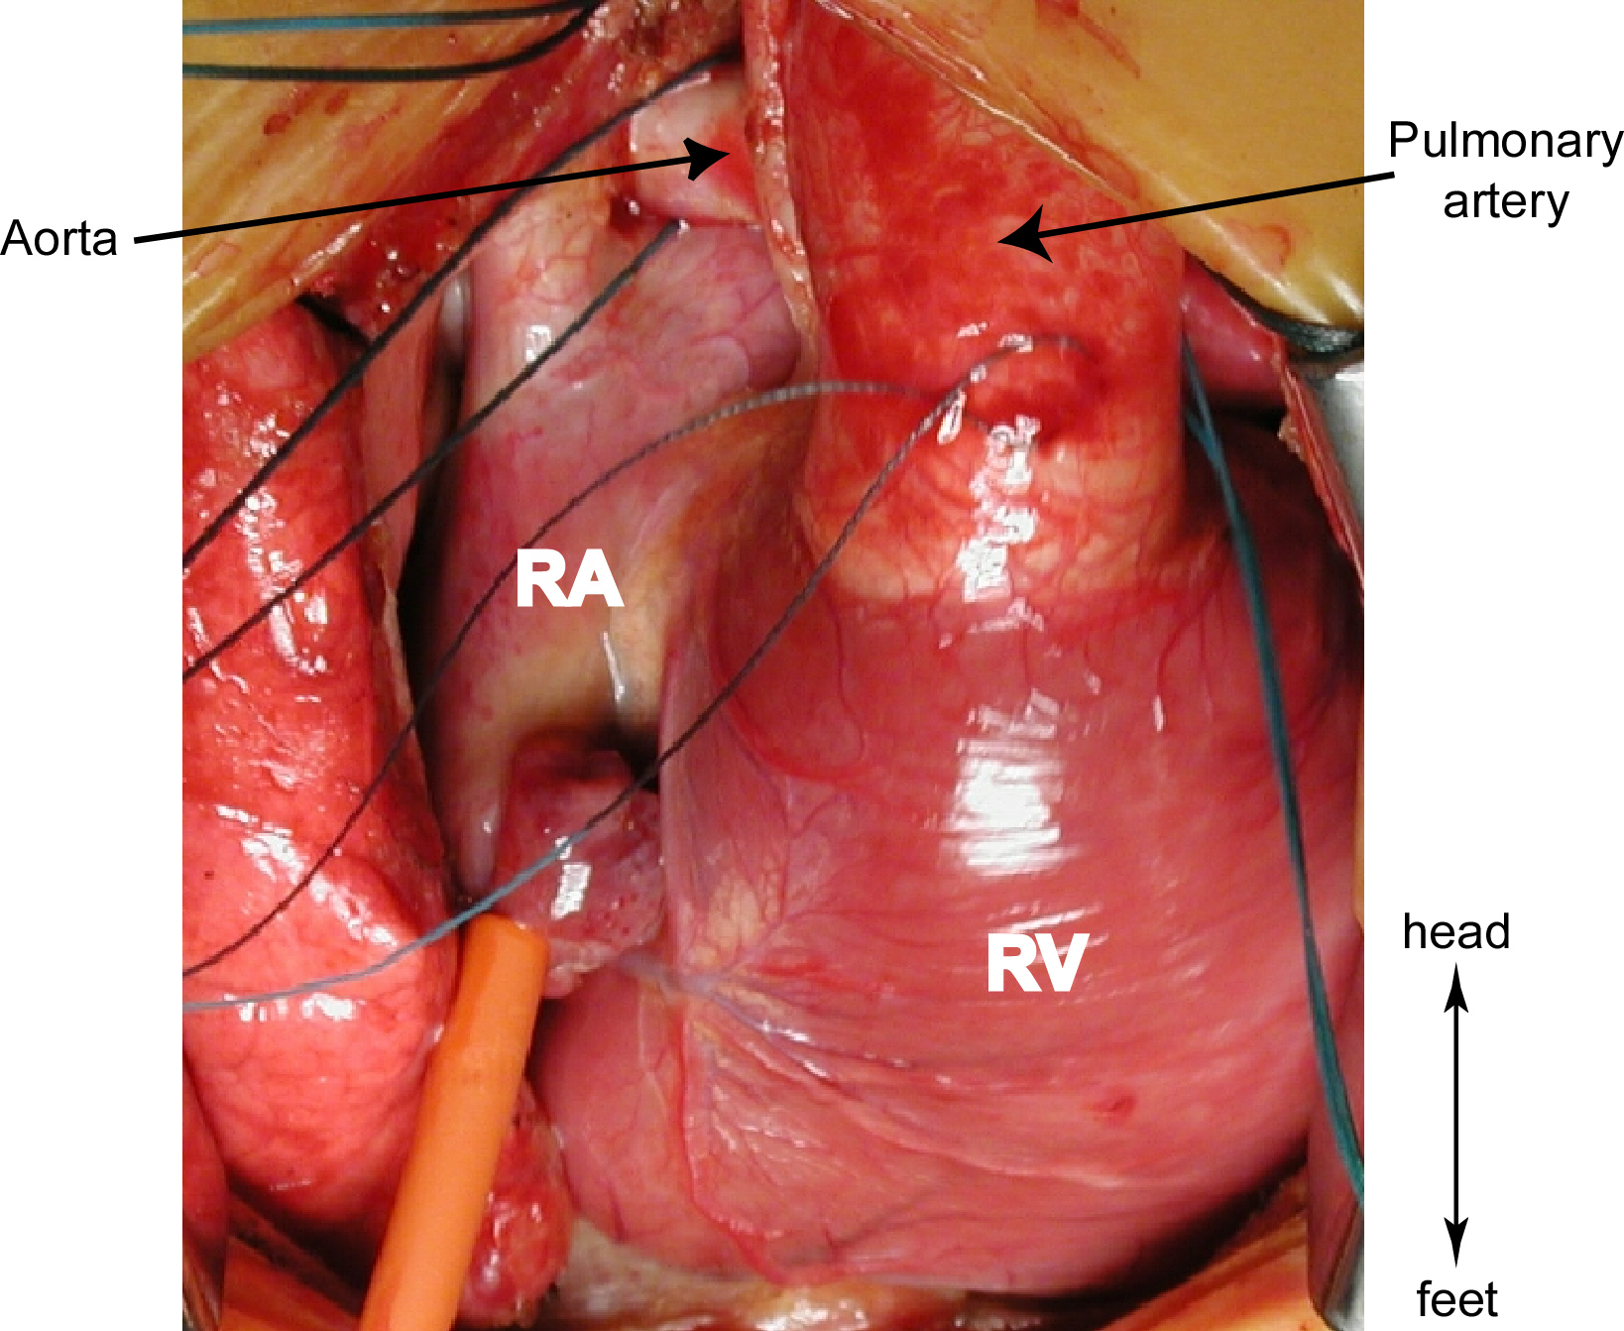

Slide 3
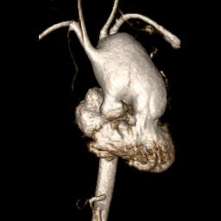

Slide 4
CASE 1

Slide 5
TODAY’S “One Liner”
24 year old young man with HLHS (MA, AA) surgically palliated to a Lateral Tunnel Fenestrated Fontan who developed progressive severe dilation of the neoaorta with LPA compression (LPA stent), neoaortic valve leakage, ventricular dysfunction, and ventricular ectopy who is now s/p aortic arch replacement (24/12/8 Gelweave coated dacron graft), Bentall aortic root/valve/ascending aortic replacement (27/29mm OnX mechanical valve composite root graft), and left pulmonary arterioplasty.

Slide 6
Began following in Fontan clinic at age 14
Mild cyanosis (~86-88%) with a fenestration
Neoaortic dilation causing some LPA compression
“We see this and will follow with MRI/ECHO”
MRI’s stable~
23-25% flow to LPA
EF’s > 50%
Minimal neo-AI and good systolic RV function
Hyperhidrosis with no clear etiology
Aspirin and Enalapril
Normal BP’s
Tall; at age 14 he was 5’9” tall
Mild scoliosis
HPI

Slide 7
Years of “stability”
College
Hyperhidrosis, but manages it, has +cough
Following the neoaortic root and neoaorta dilation
Stable neo-AI, stable RV function (EF 56%), and stable flow to LPA still >20%
Labs stable; BNP <100, stable LFT’s and platelets
Oxygen saturations stable; mid 80’s with stable hemoglobin
BP’s normal and stable
Changed to Losartan in 2016 (cough on ACE’s and neoaorta dilation)

Slide 8
Neoaorta begins to dilate more
Annual Cardiac MRI
22% flow to the LPA
Interval increase in size of ascending neoaorta
“Now 6.6 x 6.3 cm on end diastolic 3-D MRA(previously 6.4 x 5.7 cm measured at similar position”
Increased neoaortic insufficiency
Decreased combined ventricular systolic function with an ejection fraction measuring 44%(had been 56% on prior MRI)
Oxygen saturations drifting down high 70’s/low 80’s
A bit more hypertensive; Losartan is increased

Slide 9
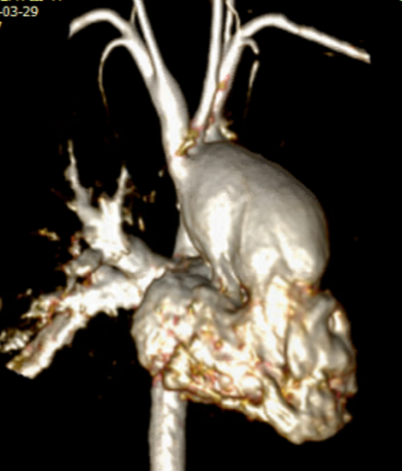
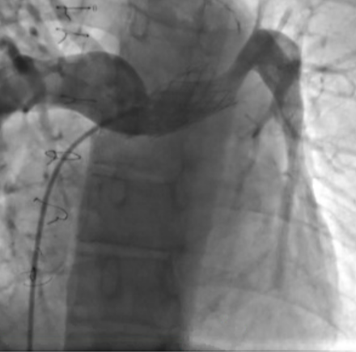
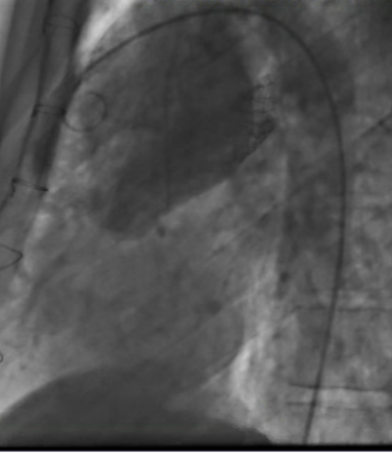
June 2019: We Have a Problem…
Graduating from college, traveling to Ireland, summer internship in NYC planned, starting his MBA in the Fall
But the cardiac MRI shows only 5% of flow to the LPA, EF 48%, increased neoaortic insufficiency(15-16%), severely dilated neoaorta with progressive dilation(7.4 cm diameter)
“Ascending neoaorta slightly superior to insertion of native aorta measures 7.4 cm. On the equivalent IR FLASH imaging on previous scan, maximum diameter was 7 cm on re-analysis at the exact same position, it is larger on the current exam.”
Can see the LPA stent in aortic images, risk for rupture?
Saturations now in the high 70’s
Holter with short, nonsustained VT and well as PVC’s
Started Atenolol for added BP management and ectopy
Cardiac Catheterization

Slide 10
Referred for surgery
Partnered with adult Marfan/Root Reduction experts at Penn (ADULT) Aortic Center
Surgery performed at CHOP
Axillary artery cutdown and bypass cannulation
Aortic arch replacement
24/12/8 Gelweave coated dacron graft
Bentall aortic root, valve, and ascending aortic replacement
27/29mm OnX mechanical valve composite root graft
Left pulmonary arterioplasty(photofix patch)

Slide 11
CASE 2

Slide 12
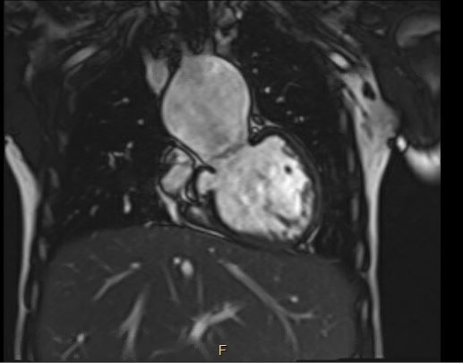
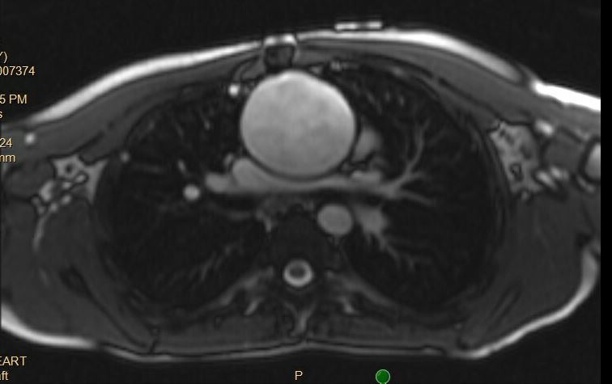
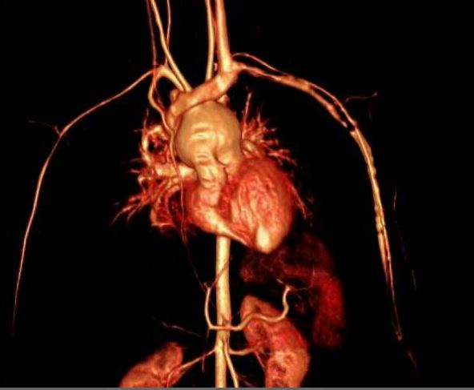
CASE 2
ECHOs = progressive Asc Ao dilation
CMR 7-21-16 (age 10): “severe asc ao dilation 5.3 x 4.8 cm, mild extrinsic compression of retro-aortic LPA; moderate systemic aorto-pulm collateral flow 20-30% of neoaortic output; LV EF= 58%; mild neo AI = 3-13% regurg fx”
CMR 7-27-18 (age 12): “severe asc ao dilation, 5.5 x 4.9 cm; moderate narrowing of LPA but good flow; cavopulm split= R:L=59:41%; pulm vein split R:L=55:45%; mild neo-AI 8%RF; LV EF=57%;”
CMR 2-24-20 (age 14): Asc Ao 5.6 x 4.9 cm; Neo AI 14%; pulm vein split R:L 56:44%; AP collateral 35% of Ao flow; MR 18% RF.

Slide 13
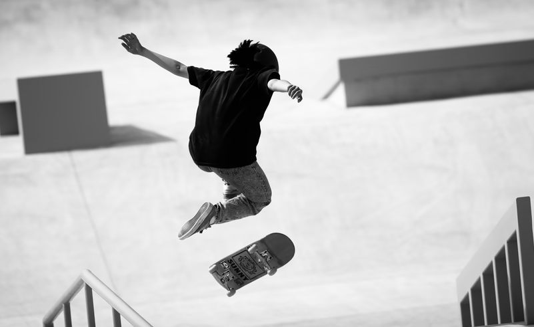
Skateboarding accident
Proximal humeral fracture with open reduction
Medications at the time:
Aspirin
Vyvanse (ADHD)
Sertraline
Risperidone
Recorded BPs
>200 mm Hg systolic!

Slide 14
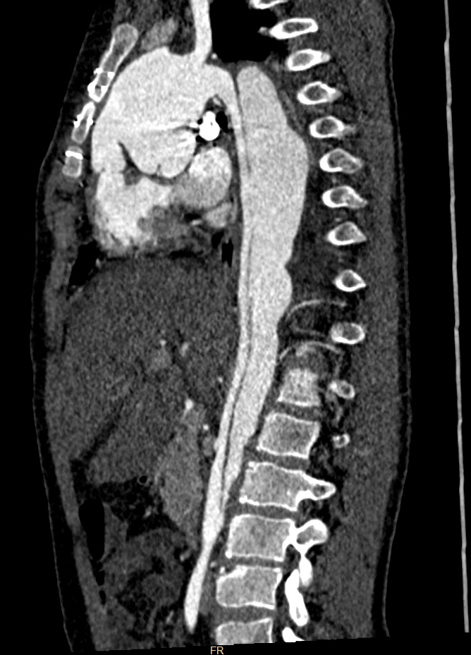
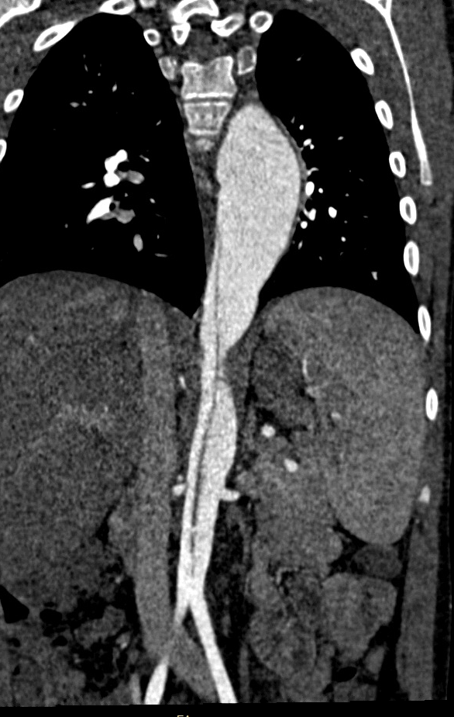
Imaging (Age 15)
Asc Ao 6.0 x 5.3
Vent EF 61%; Neo AI RF = 8%
Pulm vein split flow R:L = 64:36%
New, interesting finding…
Type B
Aortic Dissection

Slide 15
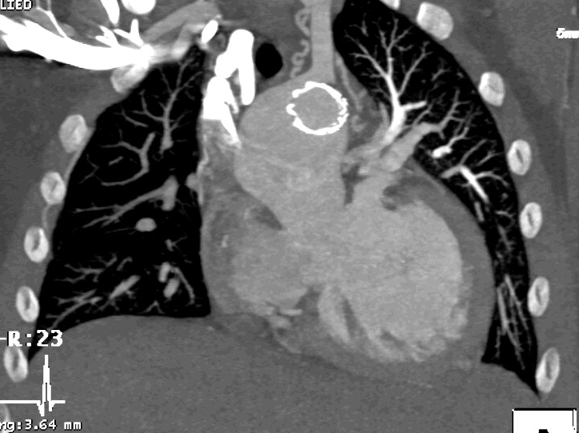
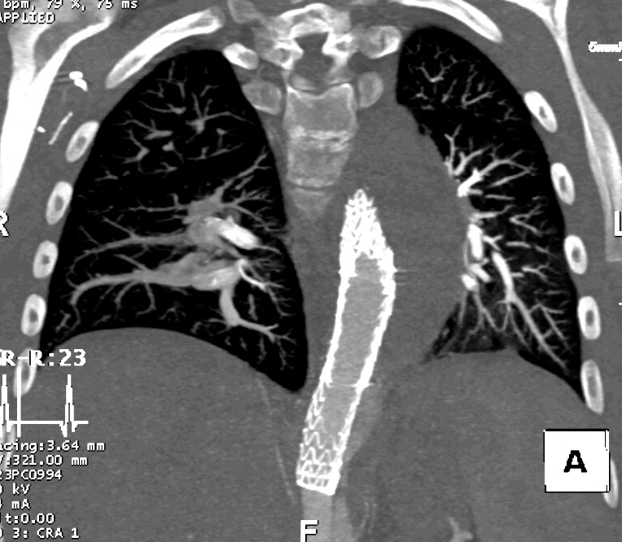
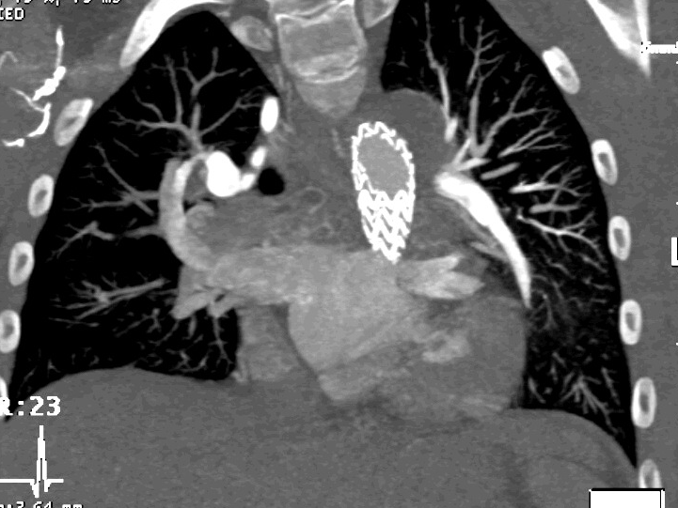
3 months later…Insertion of endovascular thoracic aortic stent graft

Slide 16
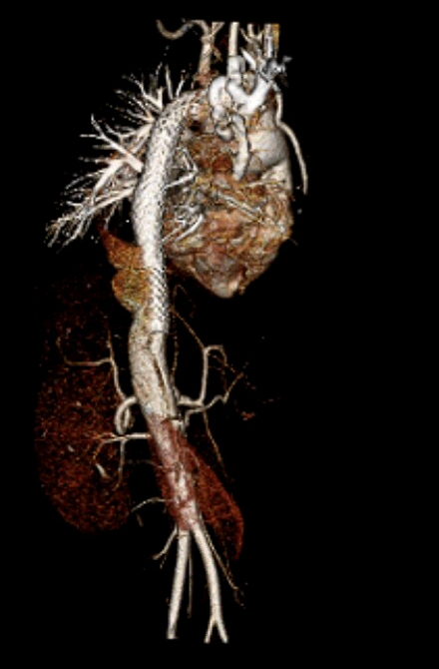
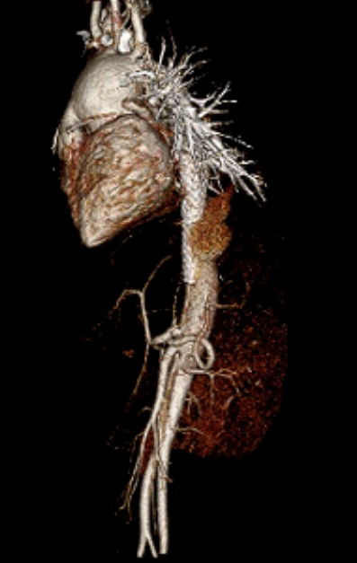

Slide 17
Summary & Lessons Learned
Aortic dilation of the reconstructed aorta is a problem with increasing frequency as patients with “Norwood” type reconstructions survive into adult life
Based on LaPlace’s law, increased diameter adds increased wall stress with risk of aortic rupture or dissection (as described in case 2)
Aortic dilation can also impact adjacent structures, leading to LPA compression or left mainstem bronchus airway compression (as described in case 1)
Aortic root replacement is a reasonable and safe strategy to undertake to prevent aortic rupture and to alleviate stress on adjacent structures
However, timing of surgical intervention is unclear. Non-reconstructed aortic criterial may not apply; we need to better understand threshold values for risk.
Proposed criteria for consideration of intervention: 1) Aortic root > 6 cm, with evidence of progression, 2) LPA compression 3) Neoartic valve insuff > moderate
Factors leading to risk of significant aortic dilation after aortic reconstruction (i.e. native aortic anatomy? rate of growth in childhood? genetic basis to aortic dilation, etc) need to be identified. This question is ripe for multidisciplinary research.

Slide 18
Community Building & Engagement
#HeartHero Campaign
Engagement Opportunities :
SV Patient Day​
SV Chats​
Social Media Takeover*​
QI Education Spring 2022 through Cardiac Networks United*​
Future opportunities for FON Workgroup participation:*​
Data & Analytics​
Quality Improvement​
Research​
Community Building & Engagement​
*Most Popular Post
Facebook
Twitter​
Instagram​
Website
April – December 2021
Total Reach: 164,169
Total Engagements: 28,185
Total Followers: 2,773

Slide 19
Year at a Glance (April - December 2021)
Total Reach: 164,169
Total Engagements: 28,185
Total Followers: 2,773

